Slide 1
Zhen Jiang
May 13, 2020

Slide 2
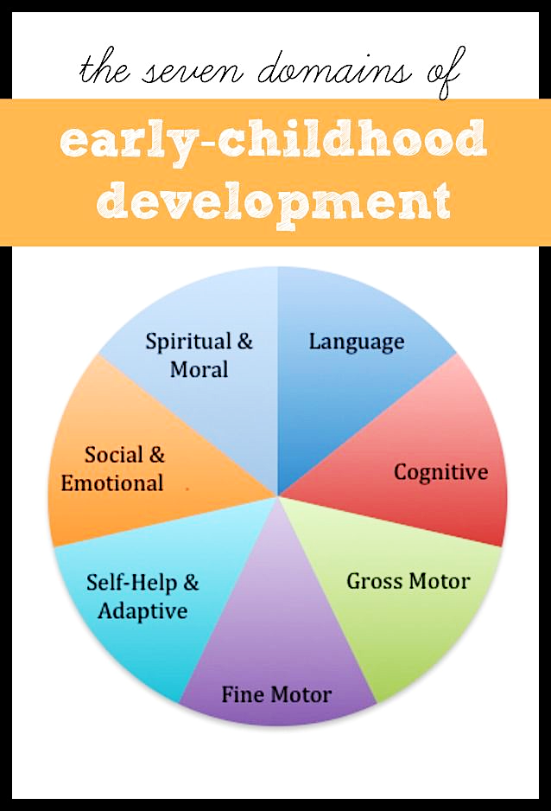
Introduction
Poetry
Effective: simplicity and brevity of thought.
Helps children pay attention to the sounds, patterns of language & encourages vocabulary.
Easy: incorporate into daily activities.
Aim
Provide potential evidences for early child language educator regarding when to provide an efficient teaching.
Notes:
Early child language development is one of the 7 domains in early childhood development. It is essential through the whole life of each person.
When teach language, educators like to introduce poetry because:
Aim: …..via analyzing a poem writing-related dataset.

Slide 3
Dataset
Poki Dataset (11MB)
https://github.com/whipson/PoKi-Poems-by-Kids/blob/master/README.md
Variable Name | Means
id | unique identifier for each poem
grade | school grade (1-12)
author | first name of author
valence | Means valence
arousal | Means arousal
dominance | Means dominance
anger | Means anger
fear | Means fear
sadness | Means sadness
joy | Means joy
total words | total number of non stop words within poem
gender | probable gender based on author name
A corpus of 61,330 poems.
Written by children from grades 1 to 12.
Especially useful in studying child language.
Emotional words:
Scored by intensity analyzed by the NRC Emotion Intensity lexicon.
Notes:
The datasets I used for this project is named Poki, it is A Large Dataset of Poems by Children
Poki is especially useful in studying child language because it comes with information about the age of the child authors as well as the emotion words scores. (school grades 1-12),
This datsset includes: var. names… the emotional words were scored by its intensity which wer analyzed by...
Words in the poem were analyzed by NRC VAD lexicon and the NRC Emotion Intensity lexicon & scored the intensity for basic emotions that are listed here.

Slide 4
Data Analysis
Aim 1
Visualize change in the number of words in a poem
View by gender
Notes:
Visualize change in the number of words in a poem (that have been created by children from different ages).
This plot shows that as children get older, their ability of writing longer poems is improved
in addition to the age factor, the gender factor was also considered since it is another important factor in child language development.
This plots shows that there is not much difference between genders regarding the total number of words. Moreover, they have the same trend.

Slide 5
Data Analysis
Aim 2
Visualize the amount of submitted poems
Grade 4 ~ 6: more active poem writers.
Grade 3: increased dramatically.
Grade 8: dropped obviously.
Gender: female submitted more poems.
Notes:
Visualize the amount of poems been submitted.
From this plot, it is obvious that children between grade 4 and 6 are more actively writing poems compare to children from other grades.
This trend actually starts from children at grade 3, when the amount of submitted poem increased dramatically compare to that of grade 2, and dropped obviously since grade 8.
Moreover, female tend to submit more compare to that of male kids.

